Slide 1
Ansor:
Generating High-Performance Tensor Programs for Deep Learning
Authors: Lianmin Zheng, Chengfan Jia, Minmin Sun, Zhao Wu, Cody Hao Yu, Ameer Haj-Ali, Yida Wang, Jun Yang, Danyang Zhuo, Koushik Sen, Joseph E. Gonzalez, Ion Stoica
Presented by: Joshua Brodsky

Slide 2
The Situation:
Incredibly large search space for optimizing Deep Neural Networks:
1.) Variety of Ecosystems
Hardware: CPU, GPU, FPGA, ASICs, etc.
Each with their own ISA
2.) Operation Diversity & Evolution
Frequent High-Level Operations: matmul, conv2d, etc.
New operations appearing

Slide 3
Existing Solutions:
Dominant Approach: Scheduling Languages (ex. AutoTVM)
Uses the TVM scheduling language but is limited by rigid, manually-written templates.
Two Complementary Levels of Optimization
Graph-Level (Relay): Reduce the number of operators
Operator-Level (AutoTVM): Optimize each operator run as fast as possible
Key Innovation of Ansor:
Automates Search Space Construction, no manual templates needed
Combines benefits of Graph and Operator level optimizations

Slide 4
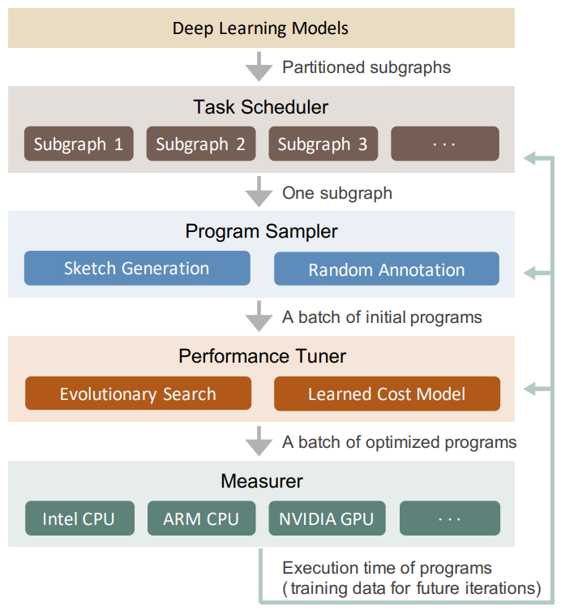
Ansor Pipeline:
Task Scheduler: Finds and prioritizes the most important tasks
Program Sampler: Generates diverse candidate programs for a single task
Performance Tuner: Evolves candidates to find the best one
Measurer: Measures program speed on real hardware for feedback.

Slide 5
Task Scheduler

Slide 6
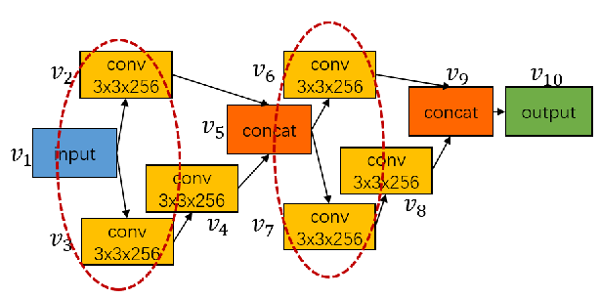
Task Scheduler:
Goal: Optimize time on the most critical tasks in a computation graph
Input: Full Computation Graph + Time Budget
How It Works:
Extract Tasks: Identify unique subgraphs
Prioritize Tasks: Weight = compute cost * call frequency
Allocate Budget: Prioritize high-weight bottlenecks
Output: Task schedule (ordering + allocation)

Slide 7
Task Scheduler: How the Scheduler Works
Initialization:
Run each task once to gather baseline performance
Loop (Scheduling Process):
Estimate Gradients: Estimate ideal performance from history, FLOPs, and task similarity
Pick Task: Select task with the highest gradient magnitude (most promising to improve)
Explore: Occasionally pick a random task using ε-greedy (exploration)
Allocate Step: Run tuning (schedule search) for that task
Update Performance: Measure results and recalculate gradients
Repeat until tuning budget is exhausted

Slide 8
Task Scheduler: Time Budget Management
Supports Prioritization of:
Maximize Throughput
Minimizes the total, combined runtime of a set of models
Meet Latency Deadlines
Stops optimizing a model once specific performance target (ex. < 10ms)
Balance Improvements
Aims for a fair and balanced speedup across an entire portfolio of models.
Early Stopping
Automatically stops optimizing a task when its performance improvements plateau.

Slide 9
Program Sampler

Slide 10
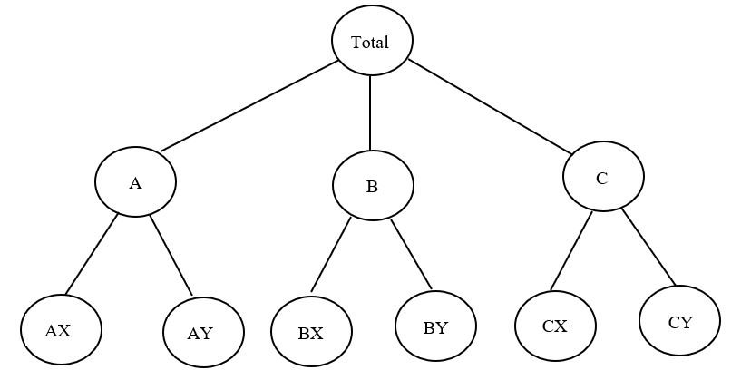
Program Sampler:
Goal: Generate a diverse set of candidate programs for each task.
Input: Prioritized Task
How It Works: A Two-Level Hierarchy
Generate Sketches (high-level templates)
Add Annotations (low-level implementation choices)
Output: Randomly sample set of complete programs (~thousands)

Slide 11
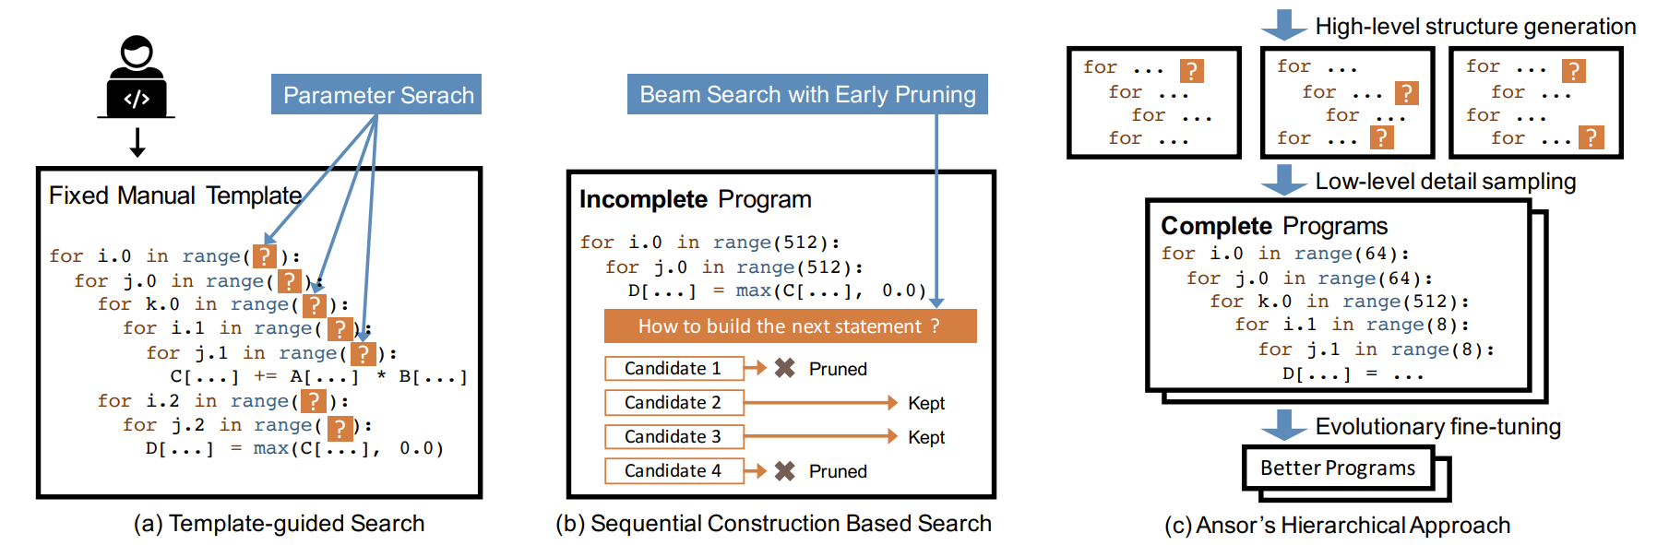
Program Sampler:
Why?
Uses random sampling to explore large search space
Template: Expands manual search via flexible derivation rules
Sequential: Avoids early-pruning program evaluation

Slide 12
Program Sampler: Sketch Derivatives
Derivatives:
If Predicate, then apply transformation
Example Predicate:
IsStrictInlinable: Inlinable simple element-wise op? (e.g., add, ReLU)
Example Transformations:
Before: TensorA -> Conv2D -> TensorB -> ReLU -> TensorC
If IsStrictInlinable? Yes!
After: TensorA -> Conv2D_with_ReLU_fused -> TensorC

Slide 13
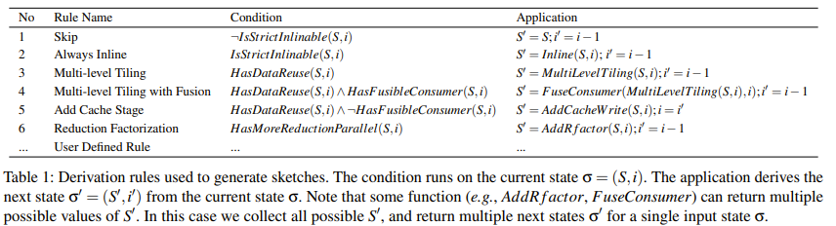
Program Sampler: Sketch Derivatives
Derivatives: Rewrite rules to apply to DAG
If Predicate, then apply transformation
Example transformations

Slide 14
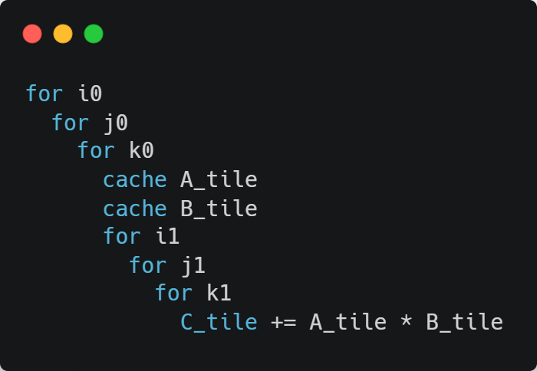
Program Sampler: Annotations
Annotation phase fills in the low-level knobs
Example Sketch:

Slide 15
Program Sampler: Annotations Example
Example Annotation A: Tile sizes: i0=64, j0=64, k0=32 Parallelize outer i0 loop across threads Vectorize innermost j1 loop Unroll inner k1 loop
Example Sketch:
Example Annotation B: Tile sizes: i0=128, j0=32, k0=16 Parallelize j0 loop instead No vectorization Unroll both i1 and j1 loops
Example Annotation C (GPU version): Tile sizes: i0=128, j0=128, k0=8 Bind i0 → blockIdx.x, j0 → blockIdx.y, i1/j1 → threadIdx.x/threadIdx.y Use shared memory for cache tiles

Slide 16
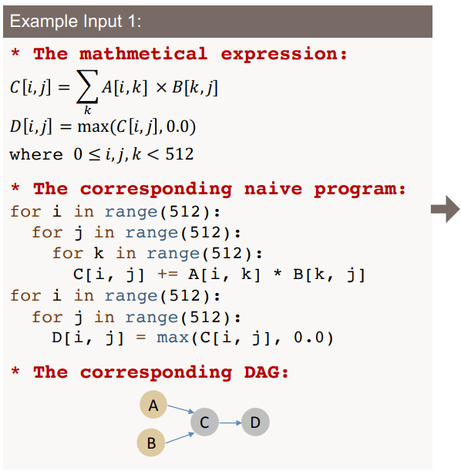
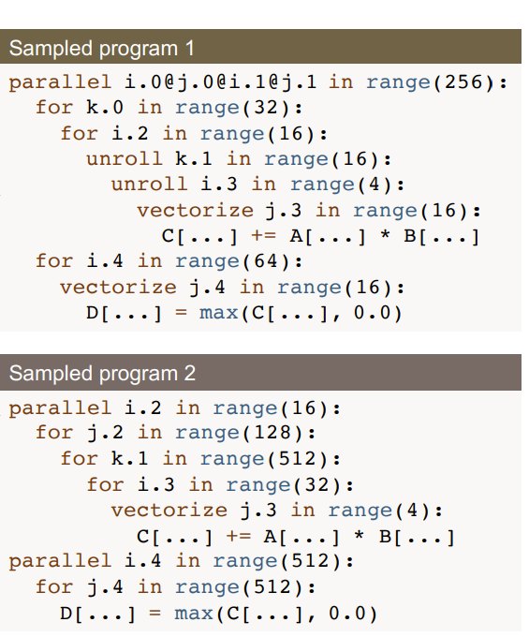
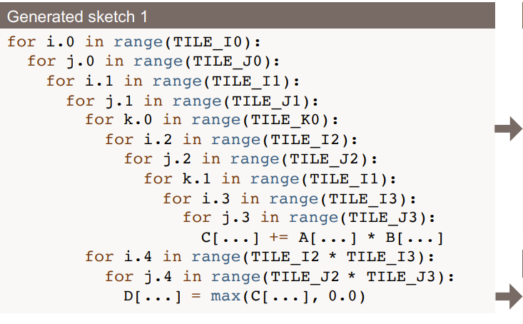

Program Sampler: All Together
Subgraph/Task
Generated Sketch
With Annotations
N Sketches…
M Annotated Programs …

Slide 17
Performance Fine-tuning

Slide 18
Performance Fine-Tuning:
Goal: Find the best program for a subgraph using a guided, evolutionary search
Input: Sampled Programs and the Learned Cost Model (LCM)
How It Works:
Start with sampled population
Evolve over generations:
Evaluate: Predict performance with the LCM.
Select: Keep the top performers ("parents").
Crossover: Merge histories of two parents.
Mutation: Randomly tweak a program's annotation.
Output: Optimized program schedule found by the search

Slide 19
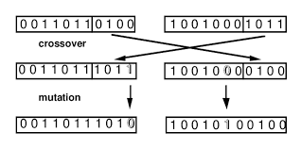
Performance Fine-Tuning:
Program's "Genes"?
Rewrite steps of a program (loop tiling, unrolling, etc.) are “DNA” of a program
Crossover: Combine rewrite histories or “DNA” of two parent programs
Mutate: Randomly change one annotation
The Full Tuning Loop (Self-Improvement):
Evolutionary search finds best programs based on LCM
Top programs are measured on real hardware
Real hardware data is used to retrain the LCM

Slide 20
Performance Fine-Tuning: Why Ansor is Better
Handles any program: not limited by hand-written templates (AutoTVM)
Powerful search: allows out-of-order changes, unlike sequential methods
Crossover & Mutation can revise early choices, avoiding common traps
Faster: ML cost function estimates runtime without executing code

Slide 21
Evaluation

Slide 22
Evaluation:
Pipeline:
Ansor IR -> TVM IR -> LLVM -> Bytecode
Evaluation Scope:
Tasks: Single Operator, Subgraph, Entire Neural Network
Hardware: Intel CPU, NVIDIA GPU, ARM CPU
Baseline:
Compare against PyTorch, Halide auto-scheduler, FlexTensor, AutoTVM

Slide 23
Evaluation: Runtime
Ansor had smaller runtime for:
Single operations
1-3D Convolution, Matrix multiplication, etc.
1.1x - 22.5x faster
Subgraphs
Combination of single operators
1.1x - 14.2x faster
Full NNs
CNNs: ResNet-50 & MobileNetV2
Transformers: BERT
1.0x - 21.8x faster

Slide 24
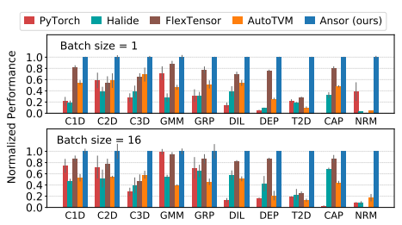
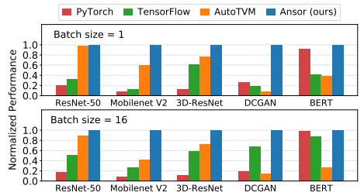
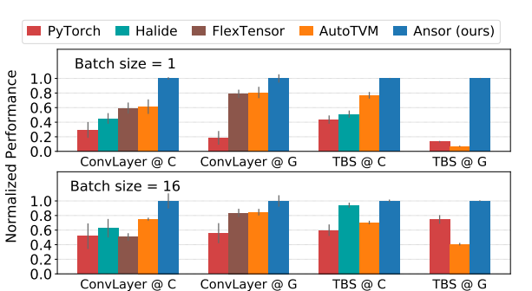
Evaluation: Runtime
Normalized Throughput with Geometric Mean (1 = good, 0 = bad):

Slide 25
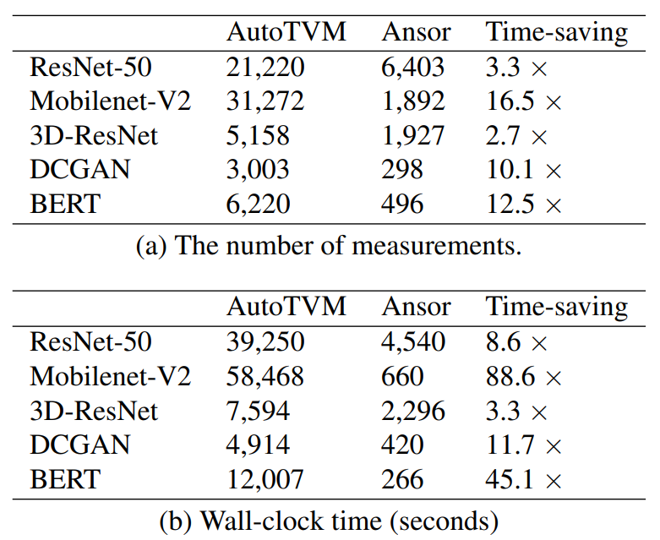
Evaluation: Search Time
Ansor accomplished 2.7x - 88.6x less search time than AutoTVM

Slide 26
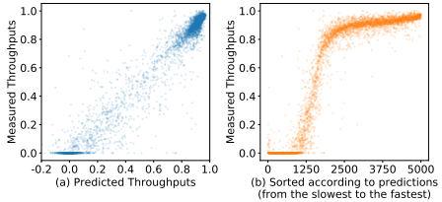
Evaluation: Learned Cost Model
The model predicts:
0.079 RMSE
0.958 R^2
0.624 recall top-30

Slide 27
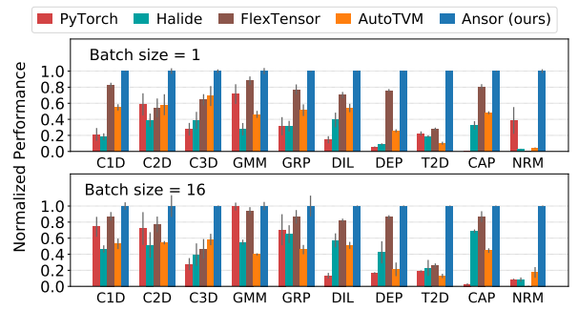
Evaluation: Single Operation
Operations:
1D-convolution
2D-convolution
3D-convolution
Matrix multiplication
Group convolution
Dilated convolution
Depthwise convolution
Transposed 2D convol.
Capsule 2D convol.
Matrix 2-norm
Hardware:
Intel CPU
Comparing Operations

Slide 28
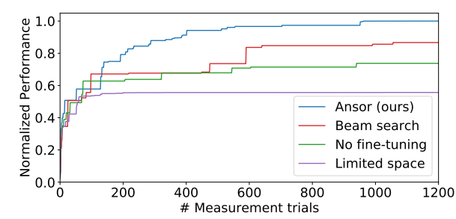
Evaluation: Ablation study (Single Operator)
Operations:
Convolution Operator
Legend:
Ansor (full optimization)
Traditional Beam Search
Ansor (no fine tuning)
Ansor (smaller sample size)

Slide 29
Evaluation: Subgraphs
Subgraphs:
ConvLayer:
2D convolution
Batch Normalization
ReLU
TPS:
2x matrix transpose
Batch matrix mult.
ReLU
Hardware:
@C - Intel CPU
@G - NVIDIA GPU
Comparing Hardware

Slide 30
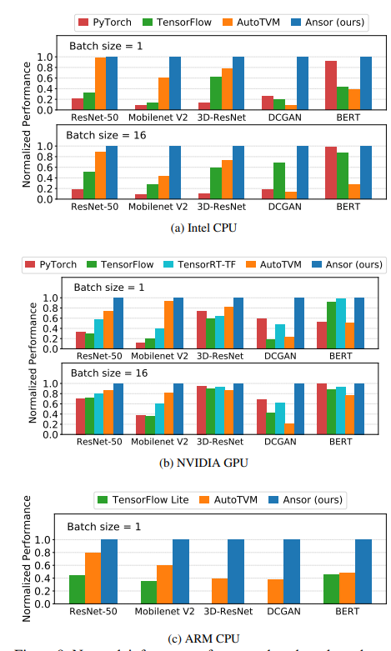
Evaluation: Full Neural Networks
Networks:
ResNet-50
Mobilenet V2
3D-ResNet
DCGAN
BERT
Hardware:
Intel CPU
NVIDIA GPU
ARM CPU

Slide 31
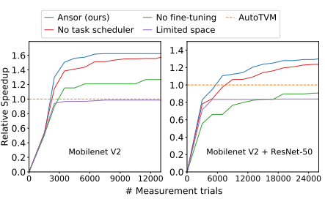
Evaluation: Ablation study (Full Neural Network)
Networks:
Mobilenet V2
Mobilenet V2 & ResNet-50
Legend:
Ansor (full optimization)
Traditional Beam Search
Ansor (no fine tuning)
Ansor (smaller sample size)

Slide 32
Limitations

Slide 33
Limitations:
No Dynamic Shape Support:
Requires static, pre-defined tensor shapes for analysis
Dense Operators Only:
Lacks support for sparse operators (ex. Graph Neural Networks)
Limited Hardware-Specific Optimization:
Relies on generic compilers (LLVM, NVCC)
Does not fully utilize vendor-specific hardware instruction tricks

Slide 34
Takeaways

Slide 35
What made Ansor so Revolutionary
Template-Free Search: Fully automates program optimization without manual rules
Expansive Search Space: Generates a vast and flexible space of potential optimizations
Learned Cost Model: Uses ML to quickly predict the performance of program candidates
Evolutionary Algorithm: Take the best program revisions and propagate
Hardware-Adaptive: Automatically optimizes for any target hardware (CPU, GPU, etc.)

Slide 36
Thank you!

